Slide 1
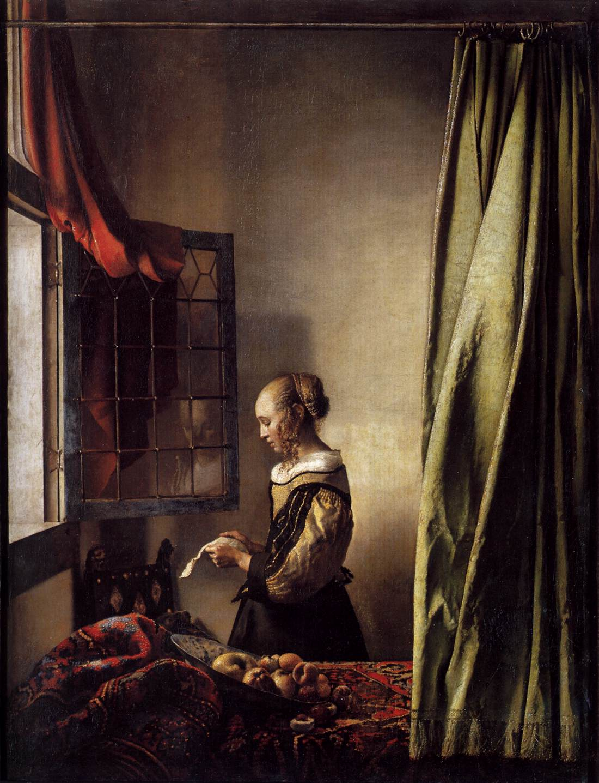
A DISH OF FRUIT Timothy Brook
莊敬
曾雅綺
詹韻蓉
邱于倫

Slide 2
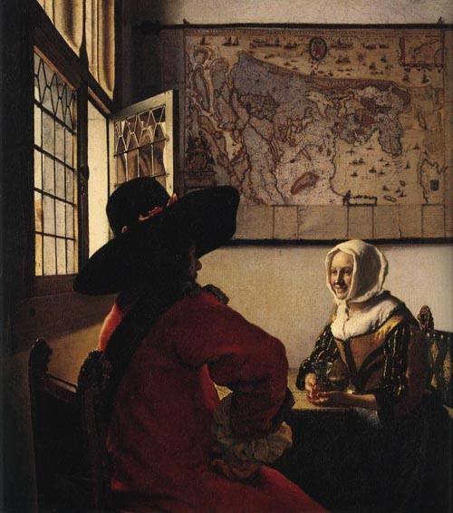
A DISH OF FRUIT by Timothy Brook
Courtship between a Man and a woman
young woman reading a letter at an open window
OFFICER AND LAUGHING GIRL

Slide 3
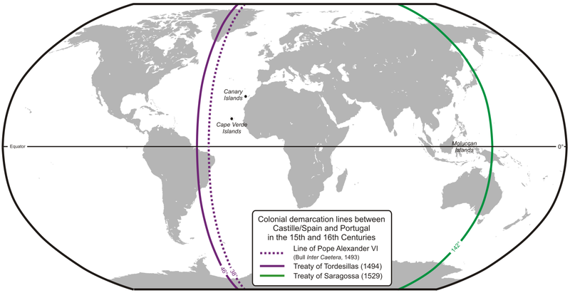
Main roles in sixteenth century
Portugal and Spain
1495 Treaty of Tordesillas
Foothold in Asia:
Portugal : Macao in China
Spice Islands
Spain : Manila in the Philippines
Trade in China

Slide 4
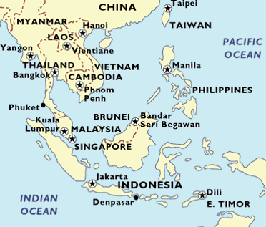
In early seventeenth century
Portugal
English and Dutch
1600 The Honorable East India Company 1602 Vereenigde Oost Indische Compagnie
Hostility between Dutch and Spain
The seizure
Foothold in Asia:
Dutch: Spice Island, Batavia (Jakarta)
Spain
Dutch
(once belonged to Portugal)

Slide 5
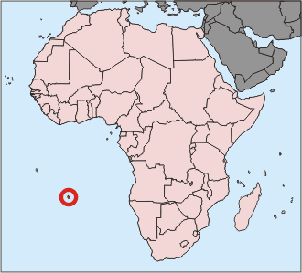
The story of White Lion (Witte Leeuw)
St. Helena, 1613
one of the ship in a convoy which was composed of English and Dutch ships
skirmish between Portuguese ships (seizure)
the explosion caused the ship to sink (the plan failed)
In 1976, the excavation of the wreck of the White Lion showed the shipment of porcelain in the early seventeenth century.

Slide 6
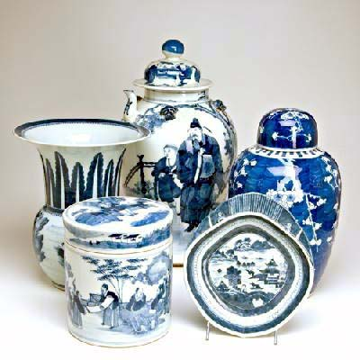
Chinese Porcelain in Europe
Its characteristics, Its history in Europe, and its influence on Europe

Slide 7
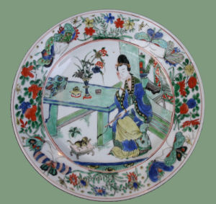
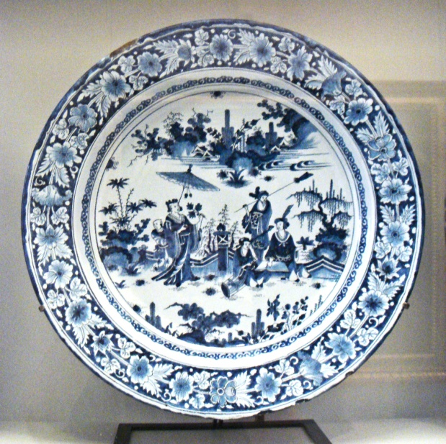
Characteristics and History
Characteristics:
Hard glazed surfaces
Vivid colors
Thinness
Translucence
History:
Blue-and-white porcelain’s birth:
Persian taste on blue-and-white porcelain
→

Slide 8
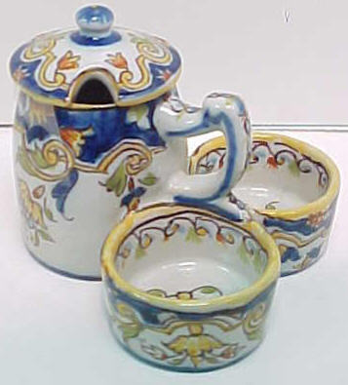
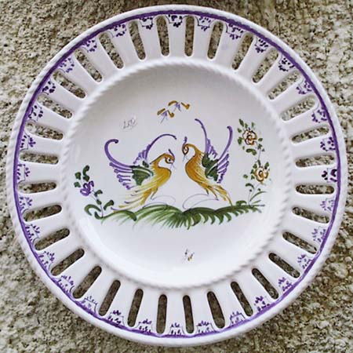
Influence on Europe
European Faience:
Its technique learned from Islamic potters
Lack Chinese thinness and translucence
Reach to Dutch
In 1596 from Jan Huygen van Linschoten, a Dutchman who went to India, learning Chinese porcelain in Goa, and inspired the coming generation of Dutch world traders by his best-selling Itinerario.

Slide 9
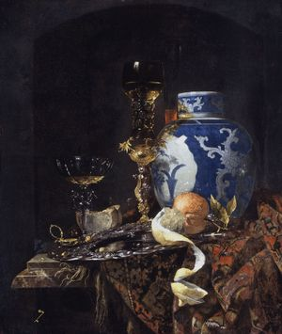
Chinese Porcelain and The Freedom of the Seas
Origin, Correlation, and Result

Slide 10
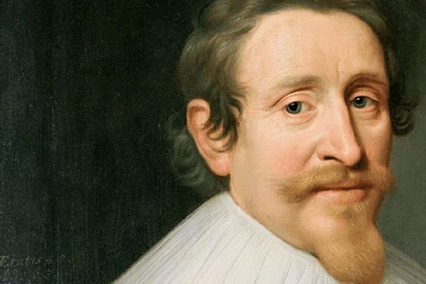
Origin and Correlation
Result
The Freedom of the Seas’ Author: Grotius
Origin: the Dutch’s “piracy” provoked Portugal and other European nations
Correlation: the maritime trade to Asia(trade in Chinese porcelain and other Asian products)
Principle of international law about the freedom of trade- all people have the right to trade
→prevent the Portuguese and Spanish from monopolizing the maritime trade to Asia, and justify the Dutch’s piracy
→ overturn “Treaty of Tordesillas”

Slide 11
Start the trade in porcelain
To trade instead of stealing
Though porcelain was not the most profitable cargo, it created the greatest presence in Dutch society.
Navigation gave the stable supply of porcelain.

Slide 12
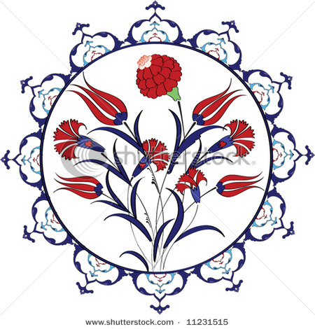
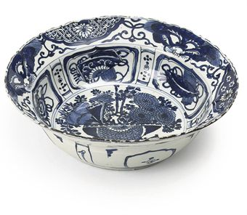
Shape to foreign tastes
Turkish tulips
Klapmuts
Both Chinese and Europeans acquired carrack porcelain, but the reason was different.
Chinese thought it embodied an exotic Western style and Europeans because it seemed to them quintessentially Chinese.

Slide 13
Porcelains in life
Art followed life, and painters put Chinese dishes into domestic scenes to lend a touch of class as well as a patina of reality.
Delftware became the affordable substitute for ordinary people.
Cash in on the taste of china.

Slide 14
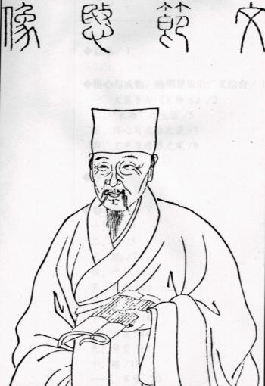
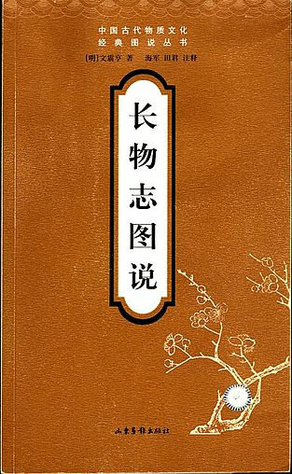
Wen Zhenheng VS. Chinese Porcelain (p. 70)
1585–1645 in Suzhou
✴ Ming Dynasty scholar, painter, landscape garden designer
Leading connoisseur and judge of taste
A Treatise on Superfluous Things
A guide to dos and don’t of
Acquiring and using nice things
For nouveaux riches
Wen Zhenheng

Slide 15
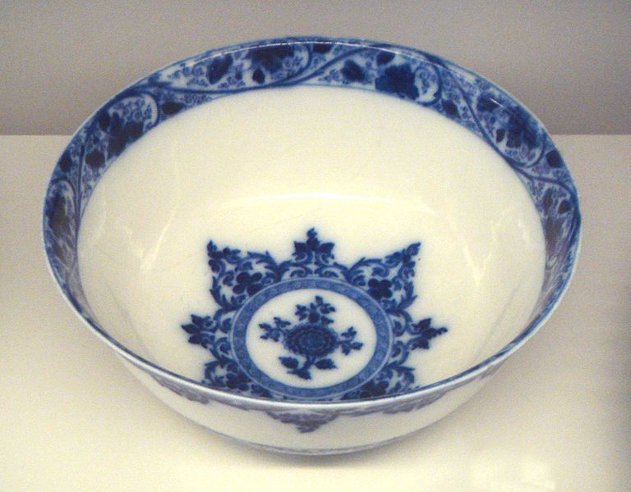
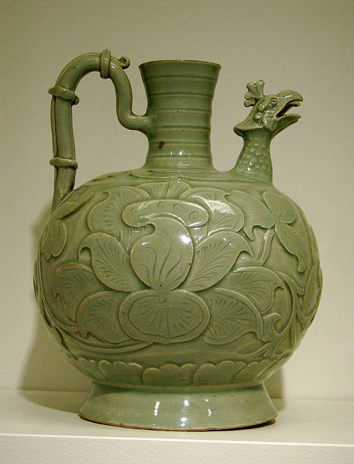
(p. 71~73)
As blue as the sky, as lustrous as a mirror, as thin as paper, and as resonant as a chime.
Value bronze and ceramic, and hold gold and silver cheap.
The only cultural values European carried was that they were rare, exclusive, and expensive.
Wealth was no guard against vulgarity.
Chinese wares surpassed in fineness, durability, style, color, and just about every other ceramic quality.

Slide 16
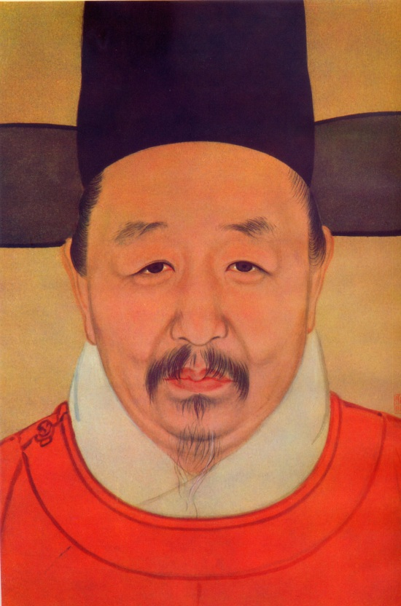
Li Rihua VS. Merchant Xia (p. 80)
✴ 1565-1635 in Jiaxing
✴ Amateur painter, a wealthy art collector
Merchant Xia’s regular customer
An old bronze water dripper &
two greenish earrings
Li enjoyed getting the better of Merchant Xia, but not out of malice.

Slide 17
Were Chinese not Curious about foreign objects?(p. 81)
Discover objects that confirmed the cultural authority of the ancients.
In Europe, where roughly a century of plunder and trade around the world had trained European into becoming connoisseurs of foreign curiosities.
Antiques were valued because they brought their owners into physical contact with a golden past.

Slide 18
(p. 82~83)
The essential impulse for collecting was to bring oneself into contact with the core values of civilization.
Europeans felt inclined to incorporate them into their living spaces, and even beyond that, to revise their aesthetic standards.
Li Rihua thought that wider world was a source of threat.
For Europeans, it was worth no little danger and expense to get their hands on Chinese goods.

